Slide 1
Undecidability

Slide 2
DEFINITION
In computability theory and computational complexity theory, an undecidable problem is a decision problem for which it is known to be impossible to construct a single algorithm that always leads to a correct yes-or-no answer.

Slide 3
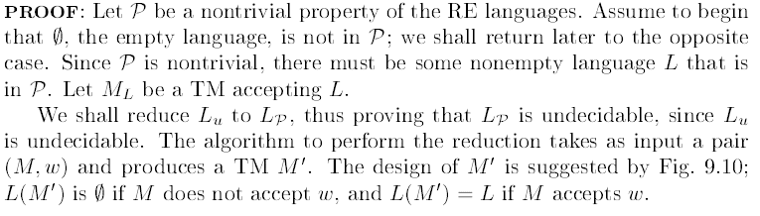

Slide 4
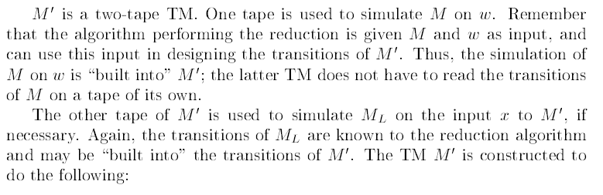

Slide 5
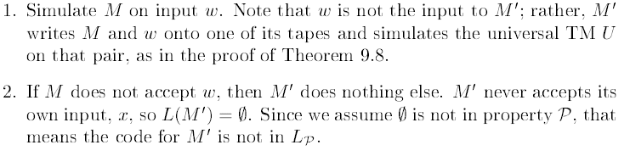

Slide 6
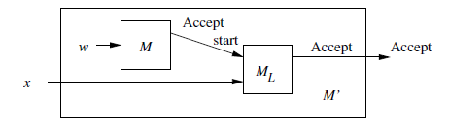

Slide 7
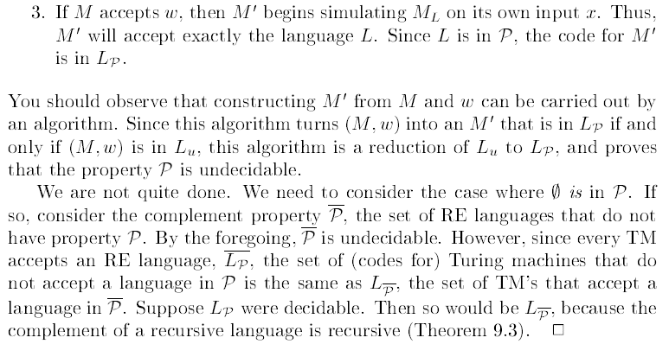

Slide 8
Undecidable problems about Turing machines
1. Given a Turing machine M and an input string w, will M eventually halt on the input w?
2. Given a Turing machine M, will M halt on empty tape?
3. Given a Turing machine M, is there any string at all on which M halts?
4. Given a Turing machine M, will M halt on every input string?
5. Given two Turing machines M₁ and M₂, will they halt on same input strings?

Slide 9
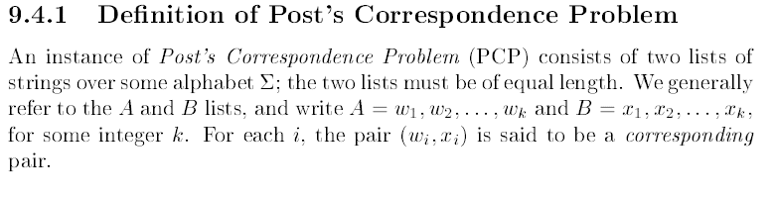
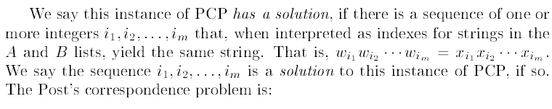

Slide 10
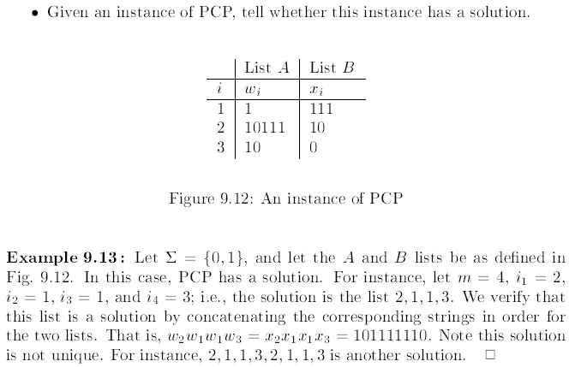

Slide 11
Decidability vs. Undecidability
There are two types of TMs (based on halting):
(Recursive)
TMs that always halt, no matter accepting or non-accepting ≡ DECIDABLE PROBLEMS
(Recursively enumerable)
TMs that are guaranteed to halt only on acceptance. If non-accepting, it may or may not halt (i.e., could loop forever).
Undecidability:
Undecidable problems are those that are not recursive

Slide 12
Recursive, RE, Undecidable languages
No TMs exist
TMs that always halt
LBA
Non-RE Languages (all other languages for which no TMs can be built)
TMs that may or may not halt
Context- free
(PDA)
Regular
(DFA)
Recursively Enumerable (RE)
Context
sensitive
Recursive
“Undecidable” problems
“Decidable” problems

Slide 13
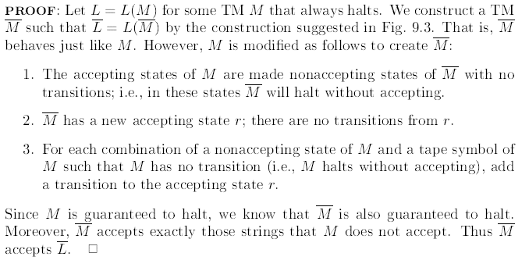

Slide 14
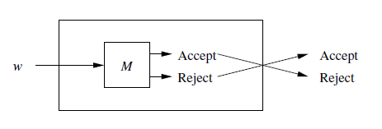

Slide 15
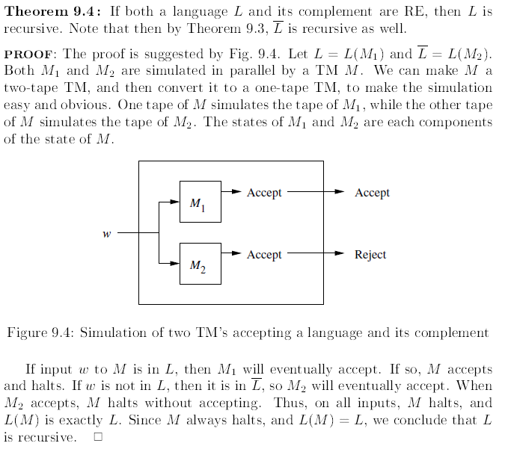

Slide 17
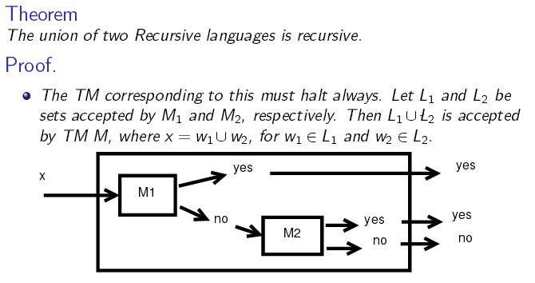

Slide 18
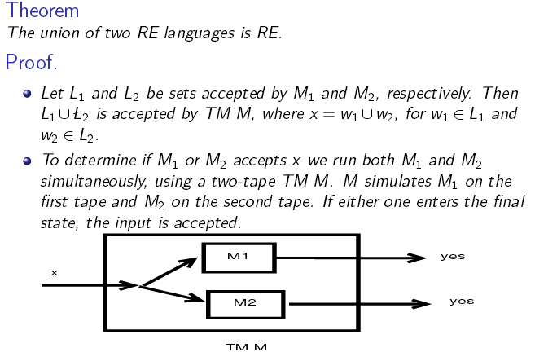

Slide 19
The Halting Problem
An example of a recursive enumerable problem that is also undecidable

Slide 20
Time and space complexity
Running time (or time complexity) for a TM is f(n), where
n is the length of the input tape
f(n) maximum number of steps/transitions the TM makes before halting
Could be infinite if the TM does not halt on some inputs
Space complexity is the maximum number of cells on the tape used/encountered by the TM during execution

Slide 21
Definition The time complexity of a Turing Machine T is the function such that is the number of steps taken by the computation T(x)

Slide 22
Definition The space complexity of a Turing Machine T is the function such that is the number of distinct tape cells visited during the computation T(x)

Slide 23
NP-complete Problem

Slide 24
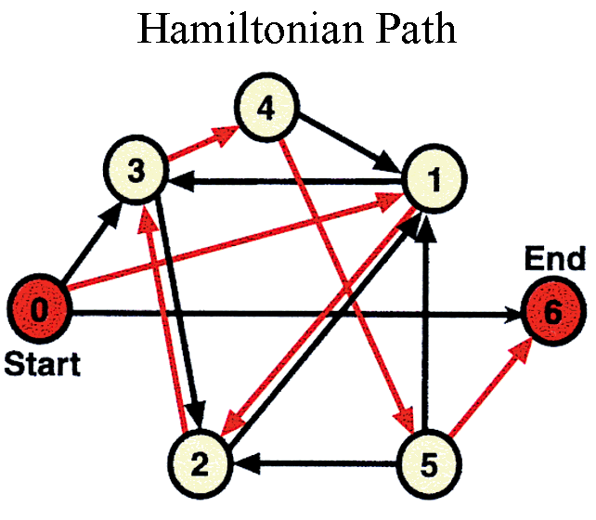

Slide 25
Decision Problems
To keep things simple, we will mainly concern ourselves with
decision problems. These problems only require a single bit output:
``yes'' and ``no''.
How would you solve the following decision problems?
Is this directed graph acyclic?
Is there a spanning tree of this undirected graph with total
weight less than w?
Does this bipartite graph have a perfect (all nodes matched)
matching?
Does the pattern p appear as a substring in text t?

Slide 26
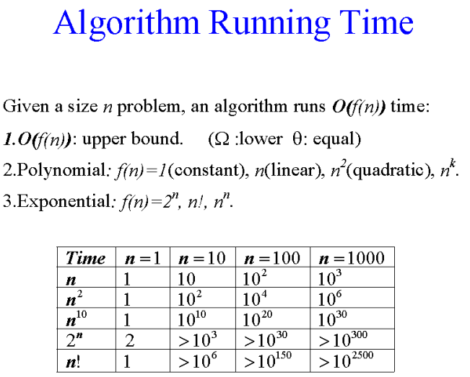

Slide 27
P is the set of decision problems that can be solved in worst-case
polynomial time:
If the input is of size n, the running time must be O(nk).
Note that k can depend on the problem class, but not the
particular instance.
All the decision problems mentioned above are in P.

Slide 28
Nice Puzzle
The class NP (meaning non-deterministic polynomial time) is the
set of problems that might appear in a puzzle magazine: ``Nice
puzzle.''
What makes these problems special is that they might be hard to
solve, but a short answer can always be printed in the back, and it
is easy to see that the answer is
correct once you see it.
Example... Does matrix A have an LU decomposition?
No guarantee if answer is ``no''.

Slide 29
NP
Technically speaking:
A problem is in NP if it has a short accepting certificate.
An accepting certificate is something that we can use to
quickly show that the answer is ``yes'' (if it is yes).
Quickly means in polynomial time.
Short means polynomial size.
This means that all problems in P are in NP (since we don't even
need a certificate to quickly show the answer is ``yes'').
But other problems in NP may not be in P. Given an integer x, is
it composite? How do we know this is in NP?

Slide 30
Good Guessing
Another way of thinking of NP is it is the set of problems that can
solved efficiently by a really good guesser.
The guesser essentially picks the accepting certificate out of the air
(Non-deterministic Polynomial time). It can then convince itself that
it is correct using a polynomial
time algorithm. (Like a right-brain, left-brain sort of thing.)
Clearly this isn't a practically useful characterization: how could
we build such a machine?

Slide 31
Exponential Upperbound
Another useful property of the class NP is that all NP problems can
be solved in exponential time (EXP).
This is because we can always list out all short certificates in
exponential time and check all O(2nk) of them.
Thus, P is in NP, and NP is in EXP. Although we know that P is
not equal to EXP, it is possible that NP = P, or EXP, or neither.
Frustrating!

Slide 32
NP-hardness
As we will see, some problems are at least as hard to solve as any
problem in NP. We call such problems NP-hard.
How might we argue that problem X is at least as hard (to within
a polynomial factor) as problem Y?
If X is at least as hard as Y, how would we expect an algorithm
that is able to solve X to behave?

Slide 33
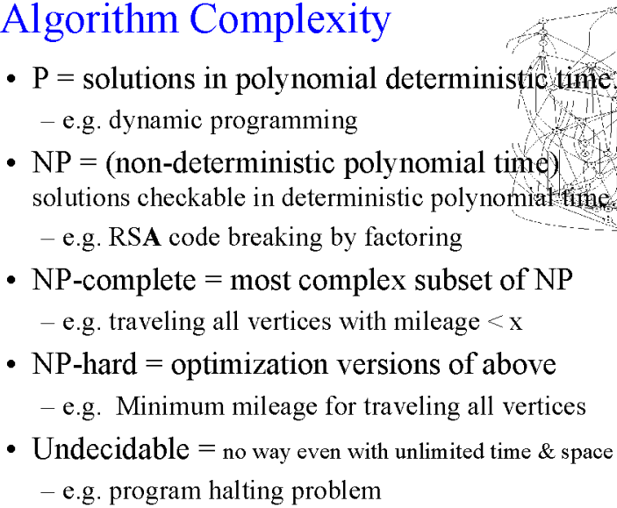

Slide 34
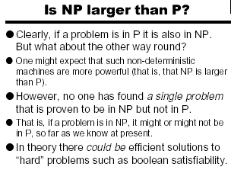

Slide 35
co-NP
NP
P
One of the central (and widely and intensively studied 30 years) problems of (theoretical) computer science is to prove that
(a) PNP (b) NP  co-NP.
All evidence indicates that these conjectures are true.
 Disproving any of these two conjectures would not only be considered truly spectacular, but would also come as a tremendous surprise (with a variety of far-reaching counterintuitive consequences).
NP-complete: Collection Z of problems is NP-complete if (a) it is NP and (b) if polynomial-time algorithm existed for solving problems in Z, then P=NP.

Slide 36
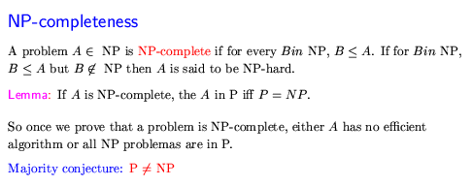

Slide 37
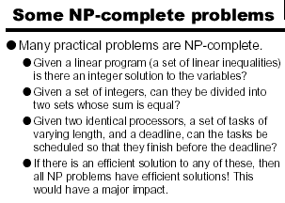

Slide 38
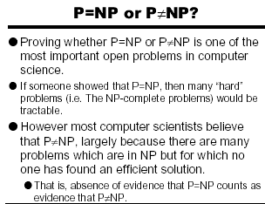

Slide 39
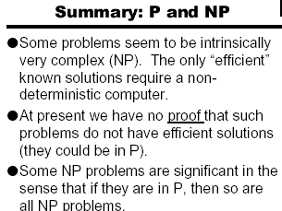

Slide 40
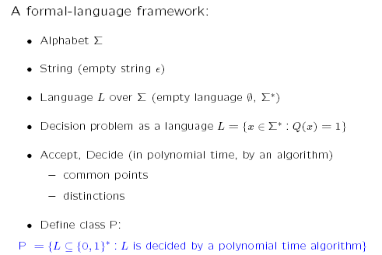
NP-Complete Problems

Slide 41
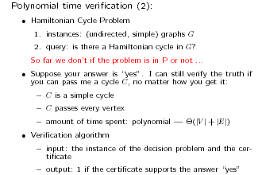

Slide 42
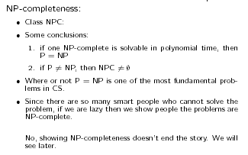

Slide 43
